Slide 1

Determination of factors influencing the academic achievement of the first-year university students using data mining methods
Harish Reddy
U85853100

Slide 2
Abstract
Our research aims to classify students into three groups: the ‘low-risk’ students the ‘medium-risk’ students, and ‘high-risk’ students.
This article describes our methodology and provides most significant variables correlated to academic success among all the questions asked to 533 first year university students during November month of academic year 2003-2004
We need to create a database in which every student is described according to characteristics such as their age, their parent’s level of education, their perception of the university environment, etc.
Idea is to determine if it is possible to predict a decision variable using the explanatory variables which we retained in the model
Finally, it presents the results of the application of discriminant analysis, neural networks, random forests, and decision trees aimed at predicting those students' academic success.

Slide 3

METHODOLOGY
Here the researchers targeted 3 sets of factors to be considered in which the first one is structural or stable factors while the other two are composed of process or changing factors. They are ;
Personal history of the student (his identity, his socio-family past, his academic past, etc.).
The expression of the involvement of the student in his studies or of his behavior in relation to his studies (participation in optional activities, meetings with his professors to ask questions or to obtain feedback on periodic examinations, etc.).
The student’s perceptions (the way in which he perceives the academic context, his professors, courses, etc.)
And Secondly, the researchers created a questionnaire allowing us to collect a large amount of interesting information on a certain number of students. The completed questionnaires led to the construction of the database in which each student is described according to a certain number of attributes such as age, education level of his/her parents, the student’s perceptions of the university world that surrounds him/her, etc.

Slide 4
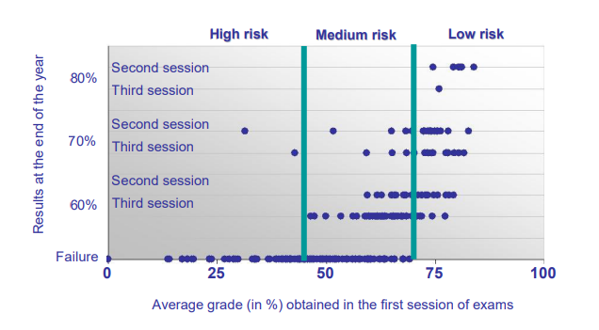
DATA
The questionnaire comprised 42 questions or question-series, almost all of them closed, from which we extracted 148 variables, most of which were either binary or coded into 5 response categories, although some were also coded as percentages. Hence each student who completed the survey would be represented by 375 variables in the database.

Slide 5
Summary of the results of validation for the decision trees
 |  | Predictions carried out by SAS/Enterprise
 |  | High Risk | Medium Risk | Low Risk
A C T U A L | High Risk | 48.65 % | 10.81 % | 40.54 %
 | Medium Risk | 33.85 % | 18.46 % | 47.69 %
 | Low Risk | 22.41 % | 17.24 % | 60.34 %
Here the researchers have used the SAS/Enterprise Miner software to build such a decision tree. A tree which presents the advantage of being particularly simple to interpret. The proportion of correct predictions in the model validation phase are not very good: only 48.65% of the students of class 1 were correctly classified by means of the elaborated tree; only 18.46% of the students of class 2 were actually classified into class 2 and 60.34% of the students of class 3 were correctly classified into class 3. We can see that for the extreme classes, the decision tree manages reasonably well, but predictions concerning students at ‘medium risk’ are rather eccentric. We obtain an overall rate of correct classification of only 40.63%.

Slide 6
Summary of the results of validation for the Random Forest
 |  | Predictions carried out by R
 |  | High Risk | Medium Risk | Low Risk
ACTUAL | High Risk | 22.92 % | 67.36 % | 9.72 %
 | Medium Risk | 6.64 % | 68.72 % | 24.64 %
 | Low Risk | 3.37 % | 41.57 % | 55.06 %
The random forests is a method that tries to build a set of individual classification trees, using each one of them a small number of variables. The idea is to build several sets of decision rules and to extract a maximum of information from the training set. R software has been used to build this method. Among all the variables, we found that the variables concerning to the estimated chances of success, the number of hours of mathematics, sciences and literature in the last year of secondary education, his/her age, among other variables, like the more important in the results. From the analysis of the results of the random forest method, presented in Table 2, we find a total rate of correct classification of 51.78%. These results are a little better than those that we obtained by the decision tree.

Slide 7
Summary of the results of validation for the Neural networks
 |  | Predictions carried out by SAS/Enterprise
 |  | High Risk | Medium Risk | Low Risk
ACTUAL | High Risk | 45.95 % | 40.54 % | 13.51 %
 | Medium Risk | 30.88 % | 47.06% | 22.06 %
 | Low Risk | 00.00% | 38.18% | 61.82 %
The Neural Network method comprises a skeleton of neurons connected to one another which breaks up into three zones: the entry layer, the hidden layers and the exit layer. The variables of the problem are acted upon and weighted by the entry layer, which then transmits this information to the hidden layers; these combine all the information into a single value which is passed to the exit neuron, and which acts as a kind of estimated value for the decision variable. On the basis of our training set containing 70% of the individuals, we built a model by means of the neural networks procedure in SAS/Enterprise. Table 3 shows, the rates of correct classification are not fantastic, even if they are slightly higher than those of Tables 1 and 2, the total percentage of correctly classified students reaching 51.88% for the neural networks.

Slide 8
Summary of the results of validation for the linear discriminant analysis
 |  | Predictions carried out by SAS/Enterprise
 |  | High Risk | Medium Risk | Low Risk
A C T U A L | High Risk | 45.95 % | 40.54 % | 13.51 %
 | Medium Risk | 22.06 % | 57.35 % | 20.59 %
 | Low Risk | 1.82 % | 30.91 % | 67.27 %
The method determines an allocation rule based on p variables which characterize each individual to be classified. This allocation rule is defined as a function of g samples taken from each of the groups. However, several solutions exist to define the classification rule which makes it possible to assign each new individual to one of the defined g classes. From the analysis of the results presented in Table 4, which are 20 - 30% worse than those that would have been observed if we had been interested in a binary variable success/failure, we find a total rate of correct classification of 57.35% - this is the least bad result of the four methods.

Slide 9
Summary & Conclusion
One variable in five proved to be correlated (of which more than one-third were very strongly correlated) with university performance. The most correlated concerned to attendance at courses, previous academic experience mainly concerned with mathematics and study skills and the estimated chance of success.
We noted that 20% of our variables showed a significant correlation with academic success. This 20% of variables are found in each of the factor categories proposed in the model. The same is true for the variables used by each of the three methods of prediction that we compared in this research.
With respect to the results obtained by the methods of prediction, we conclude that the rates of prediction obtained in validation are not remarkable. However, discriminant analysis, and to a lesser extent neural networks and random forests, seem to be able to lead to interesting results, on the condition, however, that in the future we increase the size of our samples from each university, incorporating data from an additional academic year, for example.

Slide 10

Successfully submitted!
Your submission is now waiting to be graded

Slide 11
References
J.F. Superby Production and Operations Management Department, Catholic University of Mons, chaussée de Binche 151, 7000 Mons, Belgium superby@fucam.ac.be J.-P. Vandamme N. Meskens Production and Operations Management Department, Catholic University of Mons, chaussée de Binche 151, 7000 Mons, Belgium {vandamme, meskens}@fucam.ac.b

